Slide 1
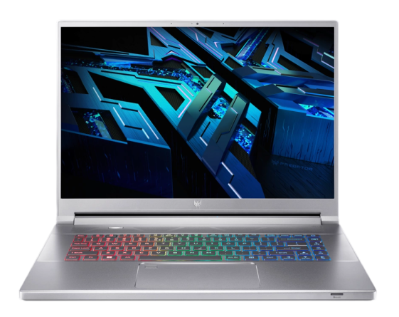
Computers in our life
Tomsk state university of control systems and radioelectronics (tusur)
Student: Muhamedzhan Adlet
Group: 543-1
Tomsk 2024

Slide 2
Content
Influence of computers on humanity
What is Acer Predator Triton 300 SE?
Characteristics
Advantages and disadvantages
List of used literature

Slide 3



Influence of computers on humanity
Education
Communication
Work
Entertainment
Health
Self expression

Slide 4
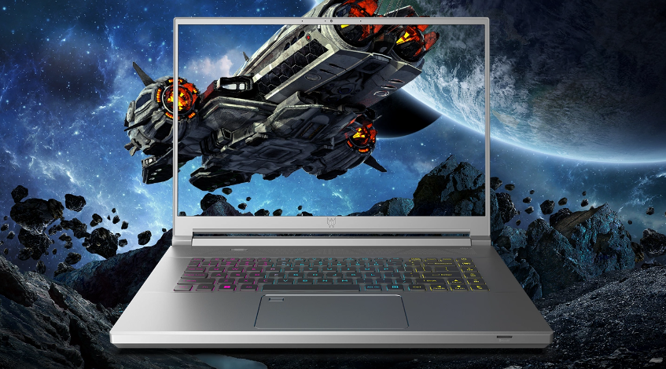
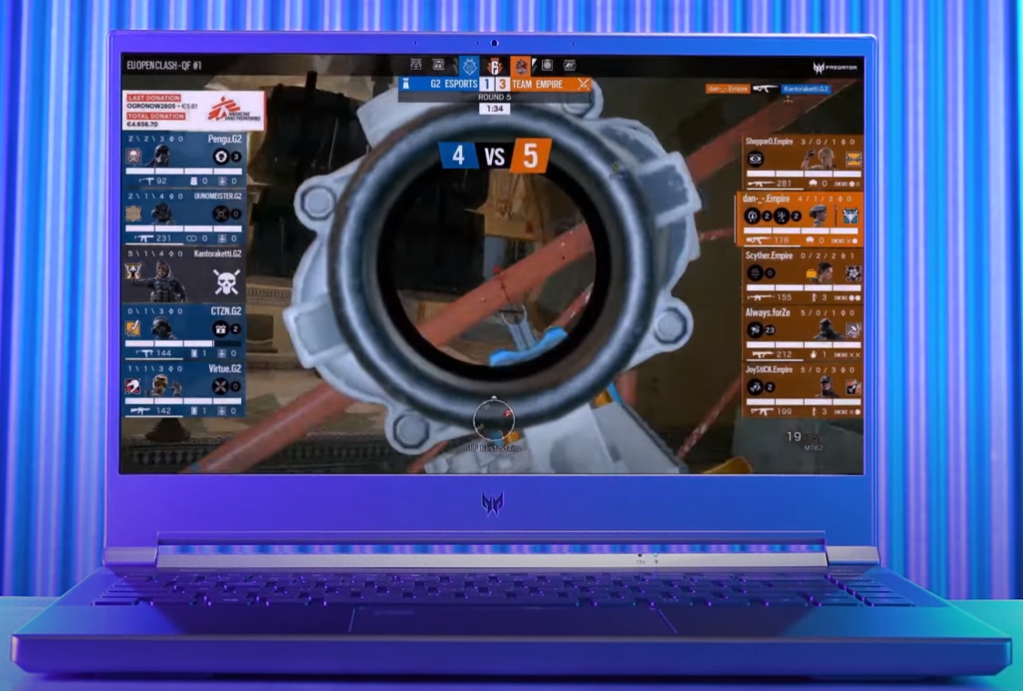
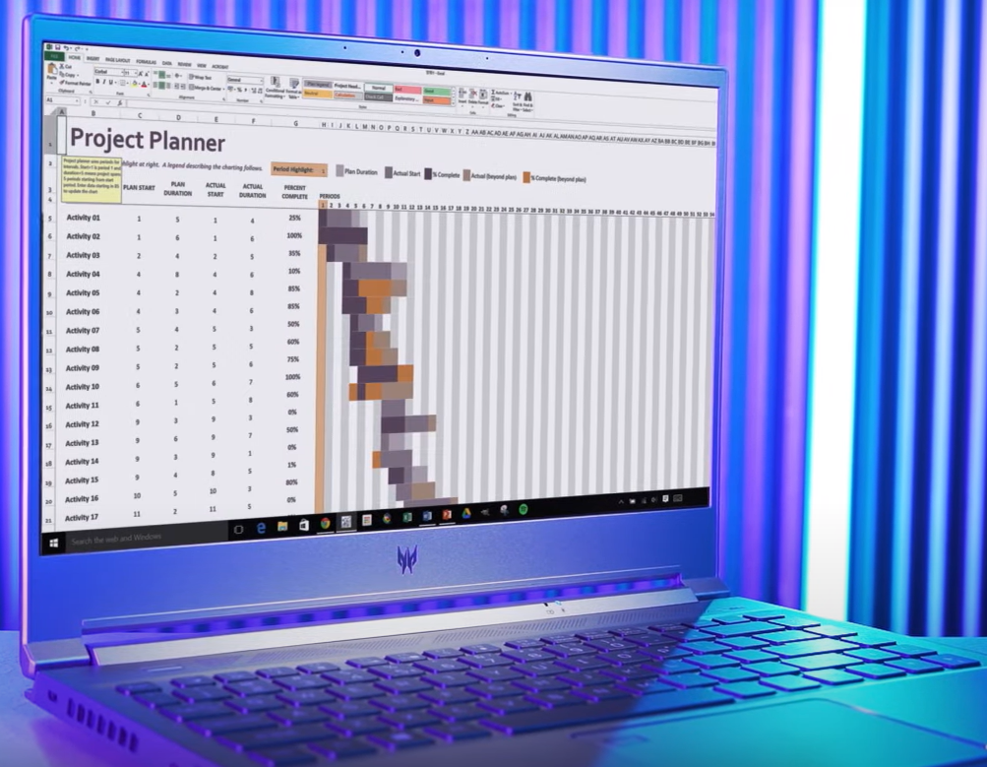
What is Acer Predator Triton 300 SE?
The slim Spartan-style Triton 300 SE gaming laptop is designed specifically to handle all your multitasking challenges, deliver exceptional performance and empower creativity at every turn. The latest Intel 12th generation processor, the best Nvidia graphics card with innovative RTX technology will help with any tasks.

Slide 5


Characteristics
Processor:11th Gen Intel® Core™ i5-11300H
Graphic card: Nvidia RTX 3060 Laptop GDDR6
Display: 14-inches FHD 144HZ
RAM: 16GB LPDDR5
Storage: 1TB SSD
OS: Windows 10 Home

Slide 6

Advantages and disadvantages
Advantages:
Convenience
Independence
All in one
Disadvantages:
Power limitation
High cost
Сomplexity of the repair

Slide 7
List of used literature
https://www.acer.com/us-en/predator/laptops/triton/triton-300-se
https://www.acer.com/us-en/predator/laptops/triton/triton-300-se/pdp/NH.QHMAA.001
Yandex images

Slide 8

Conclusion
Computers have become an integral part of modern human life. Every area of life requires digital technology, therefore it requires close attention to the quality and efficiency of our digital hands.

Slide 9
Thanks for attention!!!

Slide 10
Computers in our life
Tomsk state university of control systems and radioelectronics (tusur)
Student: Muhamedzhan Adlet
Group: 543-1
Tomsk 2024

